Slide 1


Group 5: Face Recognition Sign-In System
何沛霖 1809853U-I011-0078
陈睿 1809853Z-I011-0017
王雨阳 1809853Z-I011-0045
陈宇轩 1809853J-I011-0011
CS003 PROJECTS ON SOFTWARE ENGINEERING

Slide 2
CONTENTS
PART 01
Requirement
PART 02
Design
PART 03
Development
PART 04
Testing
PART 05
Management

Slide 3
Requirement
Existed Problems
Background Info
Environment & System Modules
Functional Requirements
Non-functional Requirements

Slide 4

Existed Problems
Existed Problems
Traditional sign-in tools, like WeMust app, is easy to forget, our software seems more direct and convenient.
WeMust cannot record the leaving time of students, some students may leave the class in the halfway, which is not allowed.
The problem of signing in with a fake face may take place in some sign-in system, but our sign-in system has relatively high recognition rate.
Sometimes app maintenance will effect the normal usage. But the independent software may reduce the impact.

Slide 5
Background Info
Background Info
Face recognition technology based on deep learning is mature enough so that it is now widely used in banks, companies, customs and universities.
There seems to be no such a sign-in system by using face in our campus. And our team expects to be a pioneer and contributes. We hope that our software can solve the existed problems.

Slide 6
Environment & System Modules
Environment & System Models
Environment
Cross-platform, mainly for Windows
Client Model
Registration Module
Sign-in Module
Statistics Module
Webpage Model
Administrator Login Module
Record Query Module
Retroactive Module

Slide 7
Functional Requirements
Functional Requirements
Registration
A button for registration
Enter student id, name and take a photo
Alert or tips (when error occurs)
Sign-in Identification
A button for identification
Take a photo and recognition, if yes then successfully sign in
Both success and failure with dialog message
Record Display
Administrator (teacher) can login the website, check sign-in results and do retroactive sign-in
The client should plot student number and attendance/absence rate

Slide 8
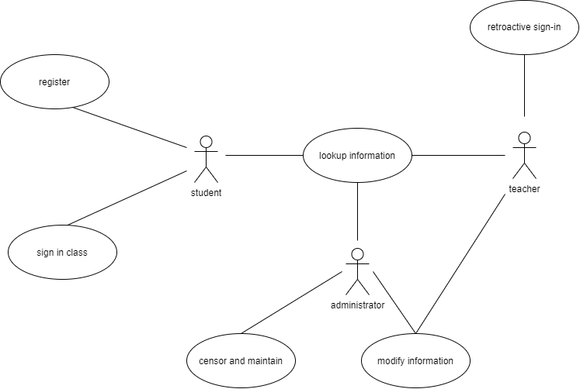
Functional Requirements
Use Case Diagram

Slide 9
Non-functional Requirements
Non-functional Requirements
Environment and Platform Requirements
Language : Python 3.7 (Anaconda)
Frontend framework : Django
Supported browsers (not Beta) : Chrome, Firefox, Microsoft Edge, Safari
Backend database : SQLite3
Client UI : PyQt5
Cloud Server Deployment (recommended but not compulsory) : Alibaba Cloud
Quality Requirements
Database capacity : Around 3000 lines of data (lite)
Quick response and low delay : < 1 second
Internet bandwidth : 5 Mbps for upload, 5 Mbps for download
Regular maintenance
Stability and security
Process Requirements
Programming thinking : OOP
Open-source platform for process supervision : Github
Plan period : 8 weeks

Slide 10
Design
Purpose
General Priority
Design Outline
Major Design Issue
Other Details

Slide 11
Purpose
Purpose
Client Design
Registration
Identification
Record Display
Website Design
Record Display
Retroactive Sign-in

Slide 12
General Priority
General Priority
Device Priority
IDE : Pycharm
Exterior device : camera
CPU efficiency : >= 800M
Network bandwidth efficiency : Upload (5 Mbps), Download (5 Mbps)
Memory efficiency : Must <= 200MB RAM.
Required memory : 128M
System Priority
Security : SSH and users' privilege licence
Maintainability : Small data capacity, limited throughput
Portability : Website supports different browsers, client software (200MB) supports different OSs

Slide 13
Design Outline
Design Outline
Architecture
General view of client & website
Class
Class diagram of client
Sequence
Sequence diagram of client
Functionality
Basic functionality for client and website

Slide 14
Major Design Issue
Major Design Issue
Face Recognition
Improving accuracy of cognition - comparing APIs and modules which are referred by Github repositories
Considering the trained dataset in the modules whether reach practical scenarios
Specific factors of environment, such as shadow, light source, masks and glasses that students wearing
Registration and Storage
Stability of database, designing with less coupling (data couple) and more reusable, increase cohesion
Flexible interface for administrators to modify and update
Particular authorities for administrators (teachers) to manage

Slide 15
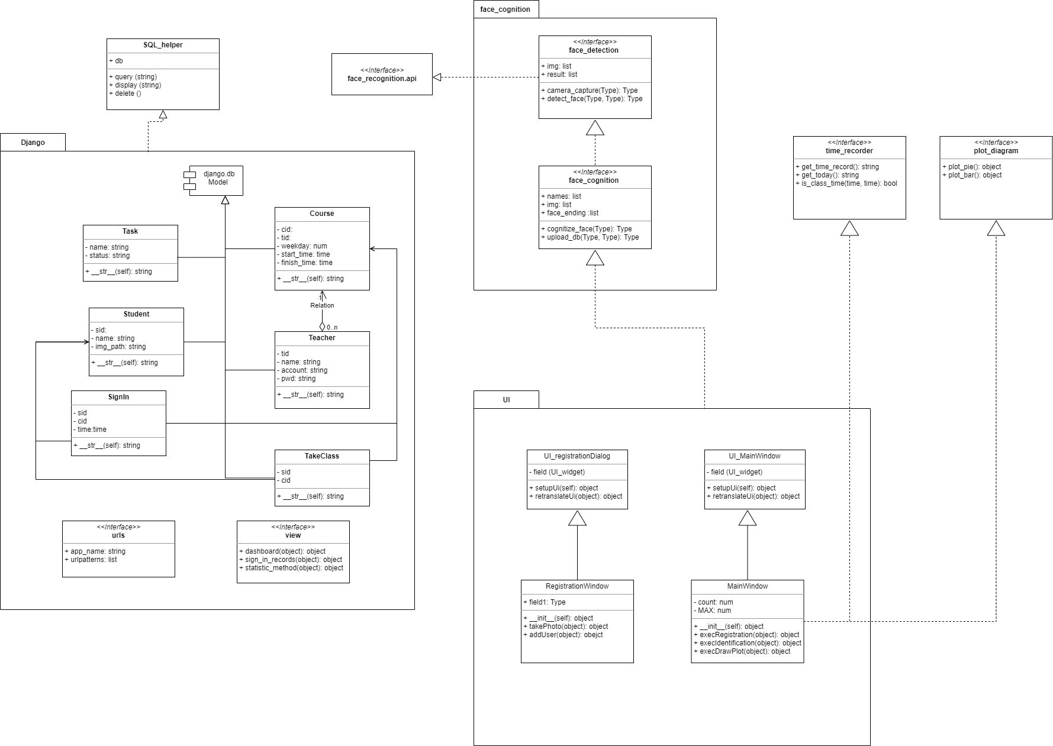
Other Details
Class Diagram

Slide 16
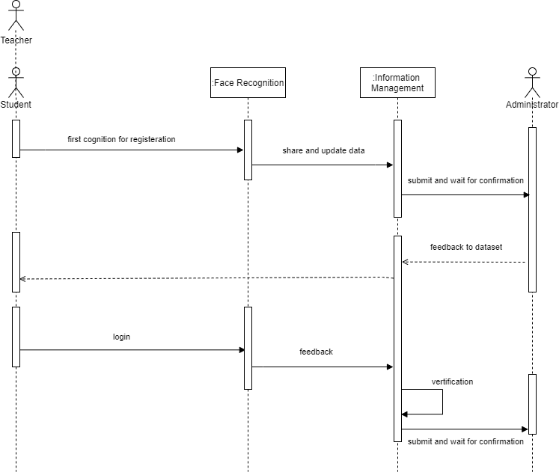
Other Details
Sequence Diagram

Slide 17
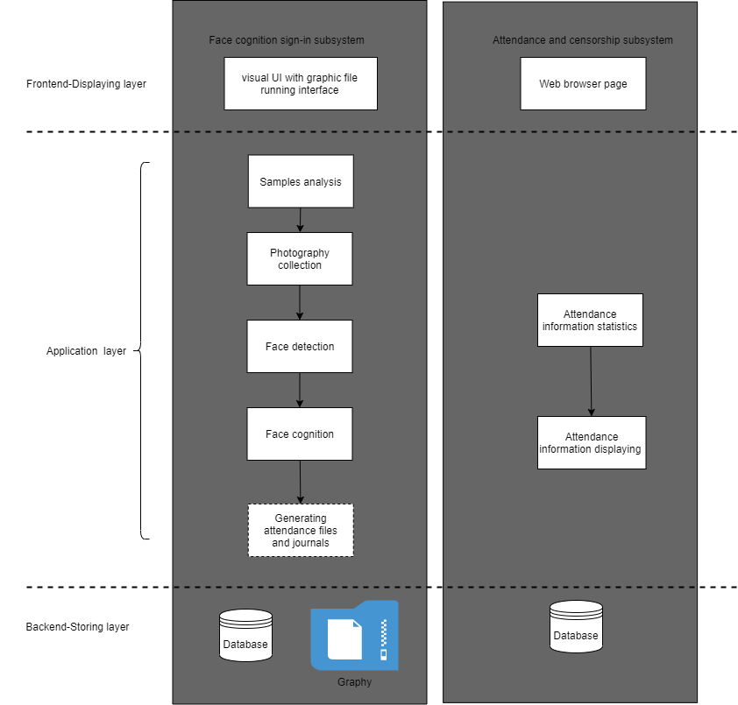
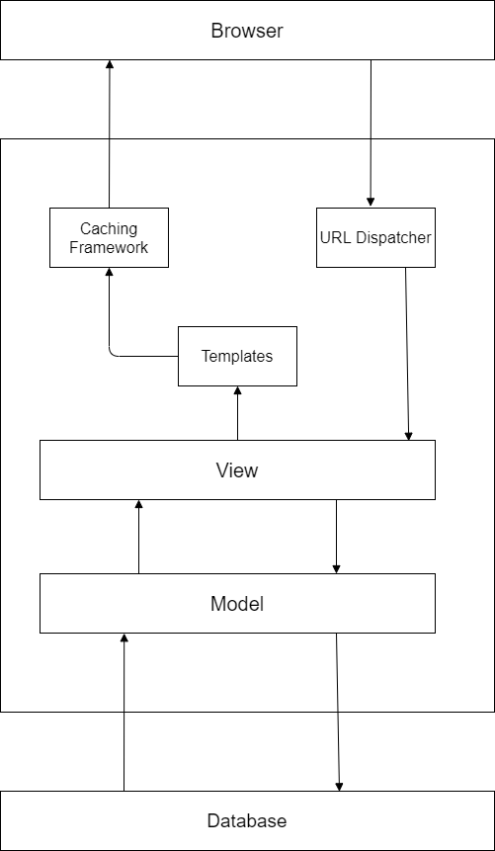
Other Details
Multi-layer Architecture Pattern

Slide 18
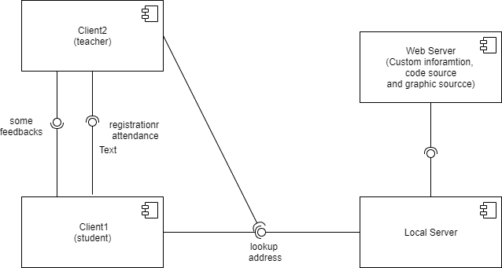
Other Details
Client-Service and Distributed Architectural Pattern

Slide 19
Development
Scrum Roles
Meetings
Leangoo
Project

Slide 20
Scrum Roles
Product Owner
Peilin He
Scrum Master
Yuyang Wang
Scrum Roles
(Egoless team)
Developer Team
Rui Chen (Developer)
Yuxuan Chen (Maintainer)
Notes:
Scrum Master :
be accountable for establishing Scrum as defined in the Scrum Guide;
helping everyone understand Scrum theory and practice, both within the Scrum Team and the organization.
Product Owner:
Developing and explicitly communicating the Product Goal;
Creating and clearly communicating Product Backlog items;
Ordering Product Backlog items;
Ensuring that the Product Backlog is transparent, visible and understood.
Developer :
Creating a plan for the Sprint, the Sprint Backlog;
Instilling quality by adhering to a Definition of Done;
Adapting their plan each day toward the Sprint Goal;
Holding each other accountable as professionals.
Maintainer :
Testing the sub-done Sprint including modifying and checking the fundamental task;
Debugging with developers and tagging the risk zone;
Monitoring the instant information flow of sessions among different users;
Supporting technological assist by contract or extra way.

Slide 21
Meetings
4 Meetings
Daily Standing Meeting
Planning Meeting
Work progress, Current Issue, Plan, etc.
Requirement, Design, Duration,
Roadmap, Milestone, Sprint & Task
Demo Meeting
Retrospective Meeting
Demonstration, Communication, Confirmation
Rethink, Summarization, Improvement, Pros & Cons
Notes:
Daily Standing Meeting
同步所有人的情況
內容快速帶過昨天做什麼/今天做什麼/目前面臨的問題是什麼
Planning Meeting
每一個 Sprint 開始前計劃本次 Sprint 要做什麼，阐述需求
並且跟著工程師一起拆分任務（大需求拆成小任務的概念），以及大家估計每個任務大概需要做多久
确定roadmap，milestone，根据milestone组成sprint
PO, Scrum Master 与 Developer Team 交流，确定技术路线和明确任务规划
Demo Meeting
開發團隊展示他的成果，展示测试和开发结果
Po和SM确认开发人员的工作和用户需求相同
Retrospective Meeting
大家反思在开发流程中的错误和经验，总结好的方面，反思不好的方面，以提升团队的磨合。燃尽图

Slide 22
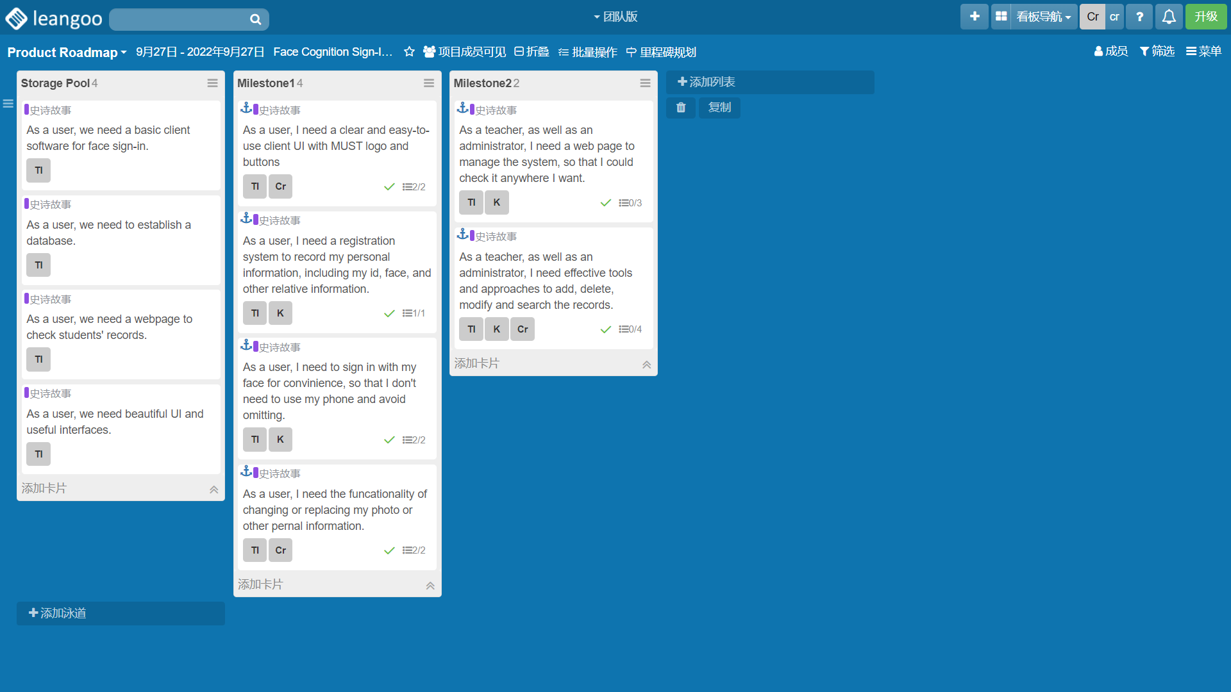
Leangoo – Product Roadmap
Planning Meeting

Slide 23
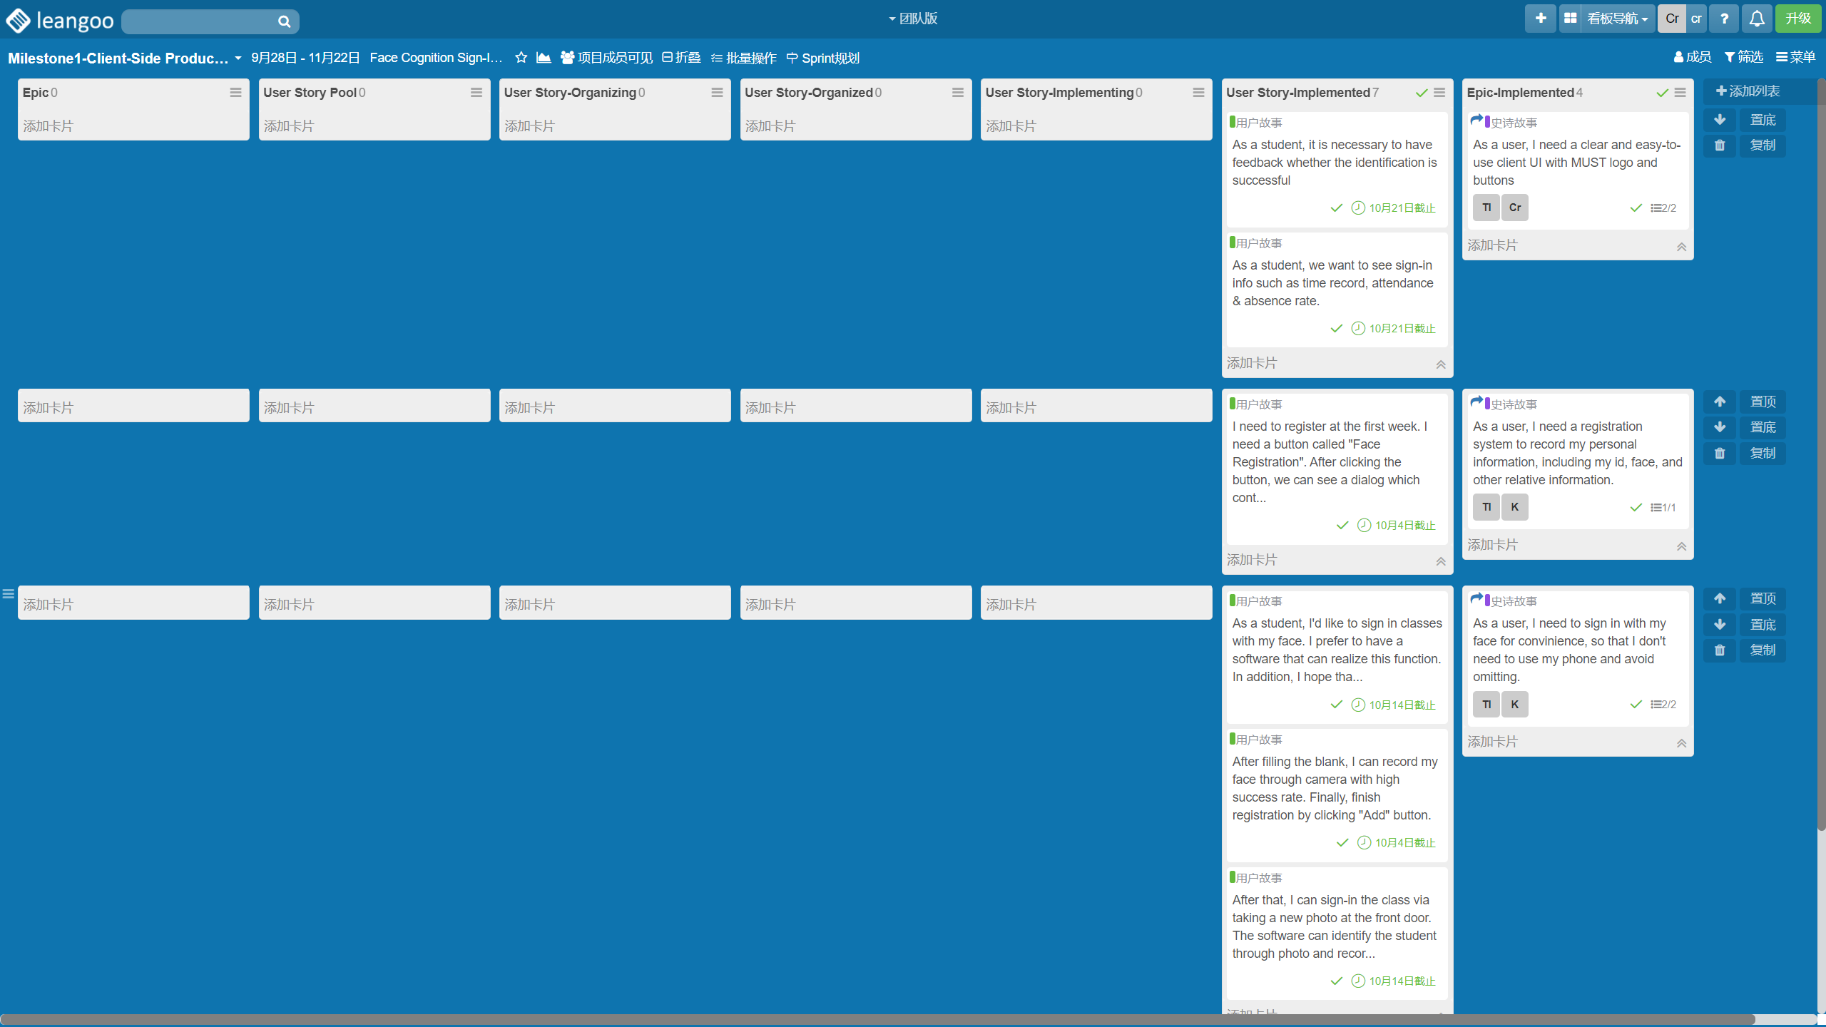
Leangoo – Milestone 1: Client-Side Product Backlog
Planning Meeting

Slide 24
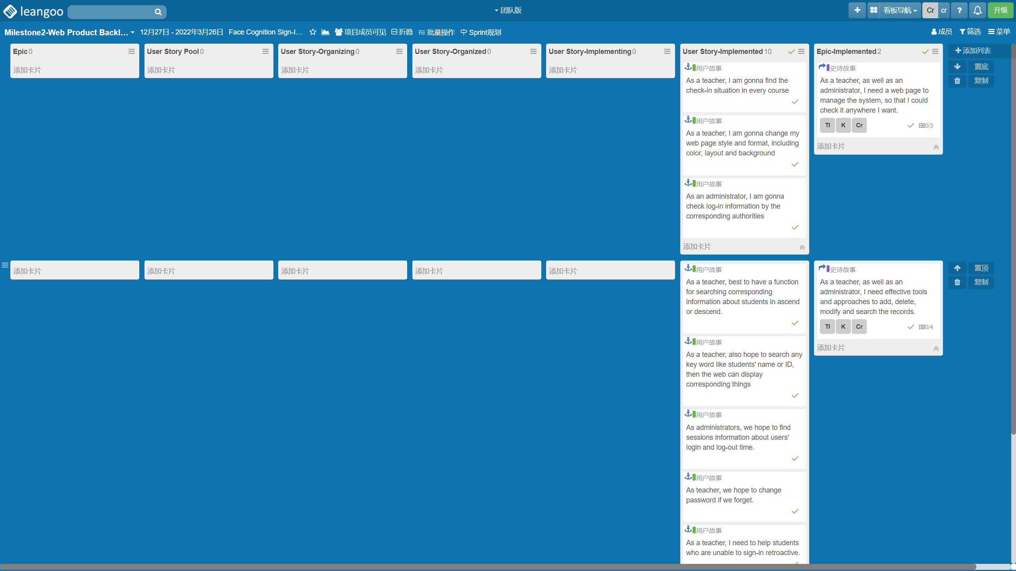
Leangoo – Milestone 2: Web Product Backlog
Planning Meeting

Slide 25
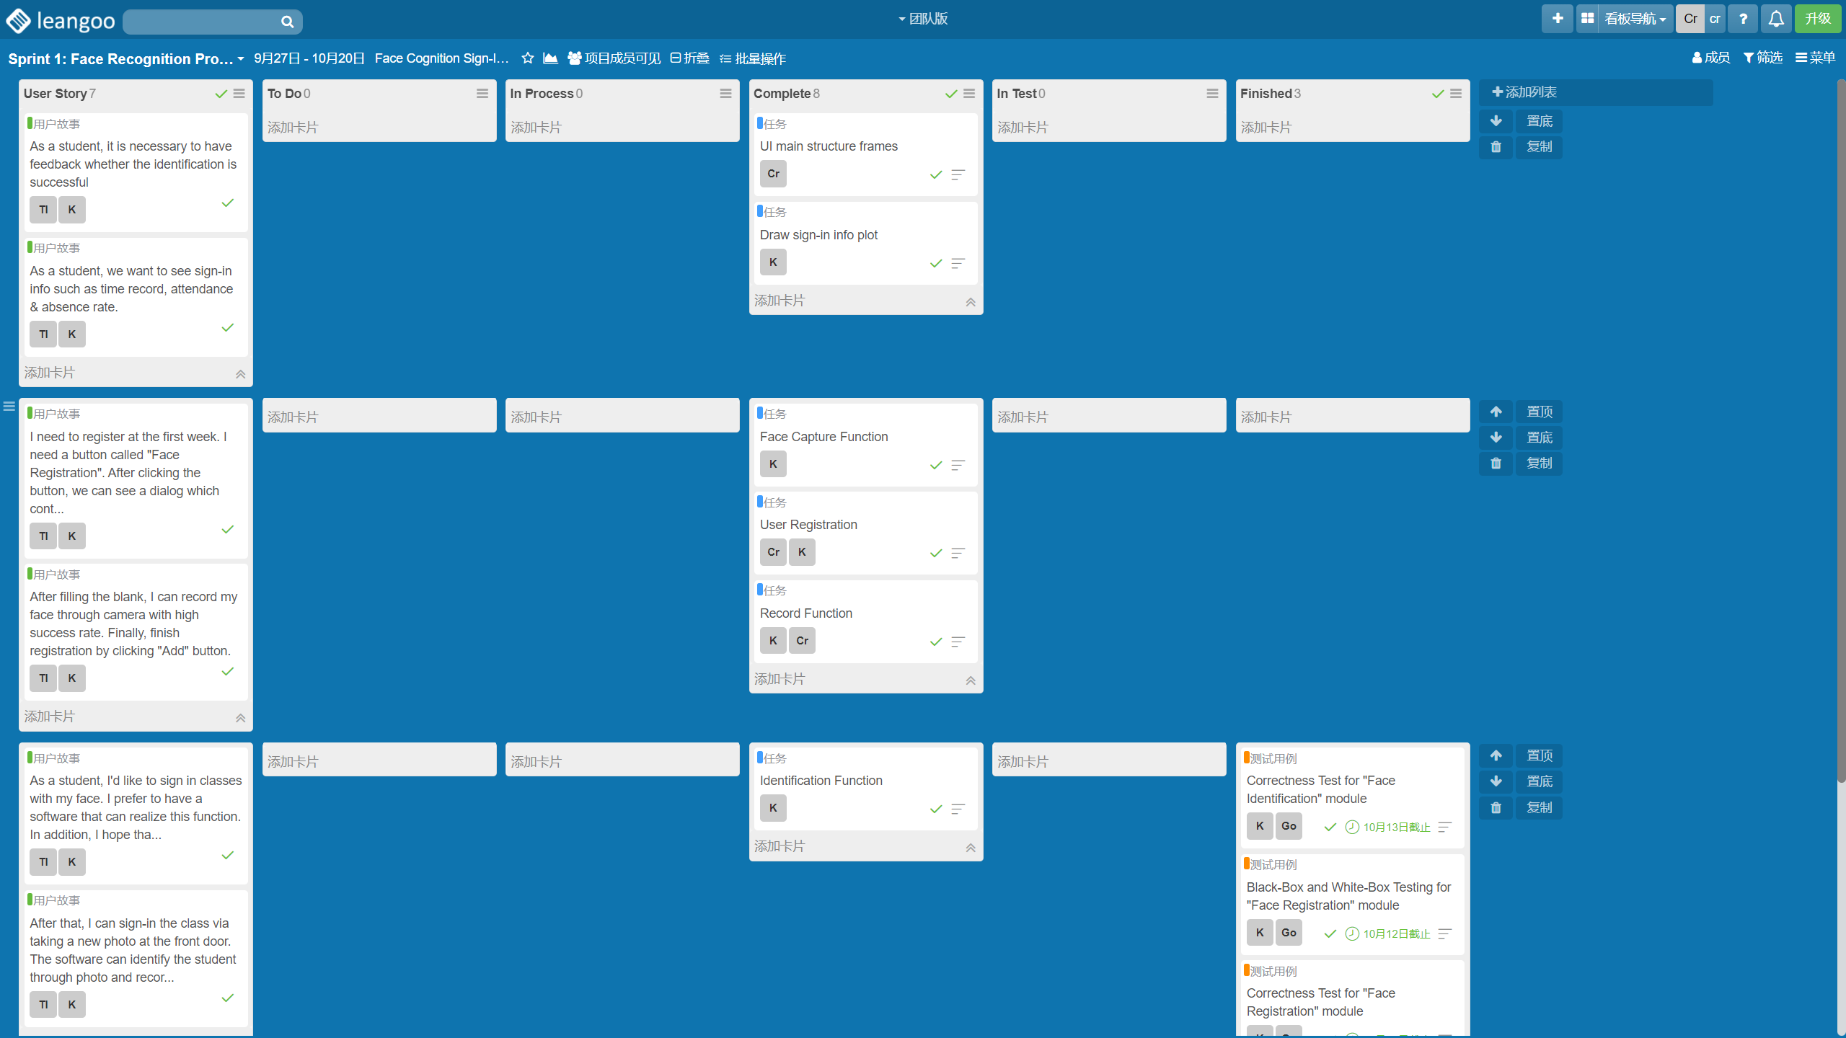
Leangoo – Sprint 1: Face Recognition Prototype
Daily Standing Meeting & Demo Meeting

Slide 26
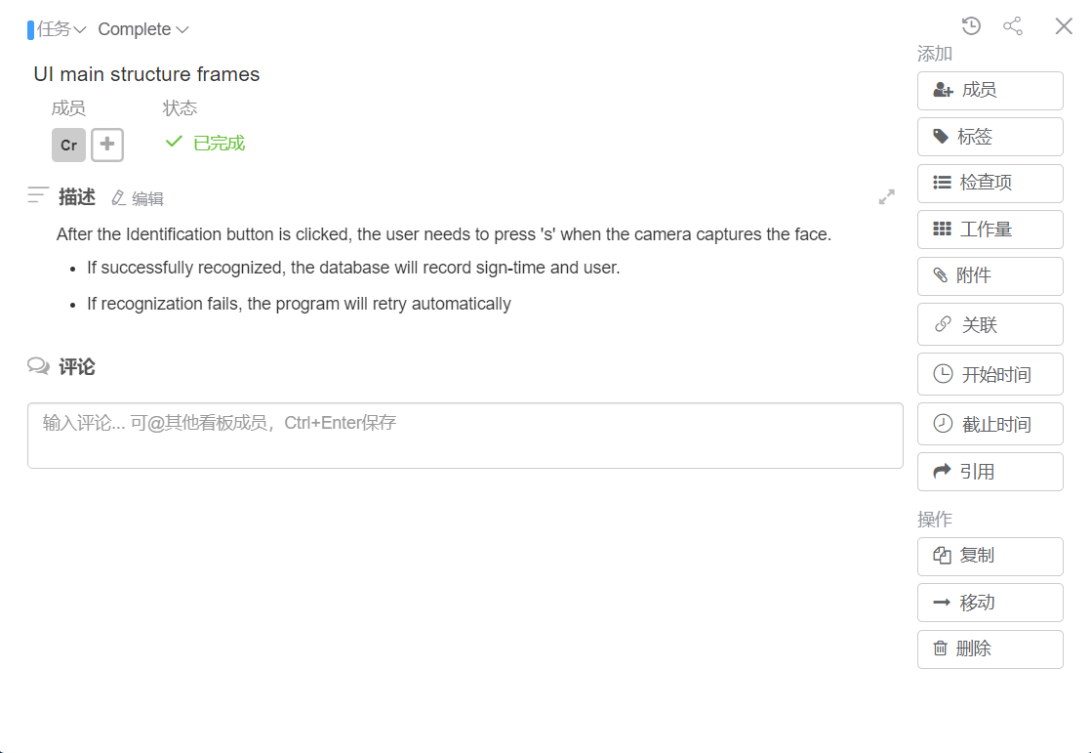
Leangoo – Sprint 1: Face Recognition Prototype

Slide 27
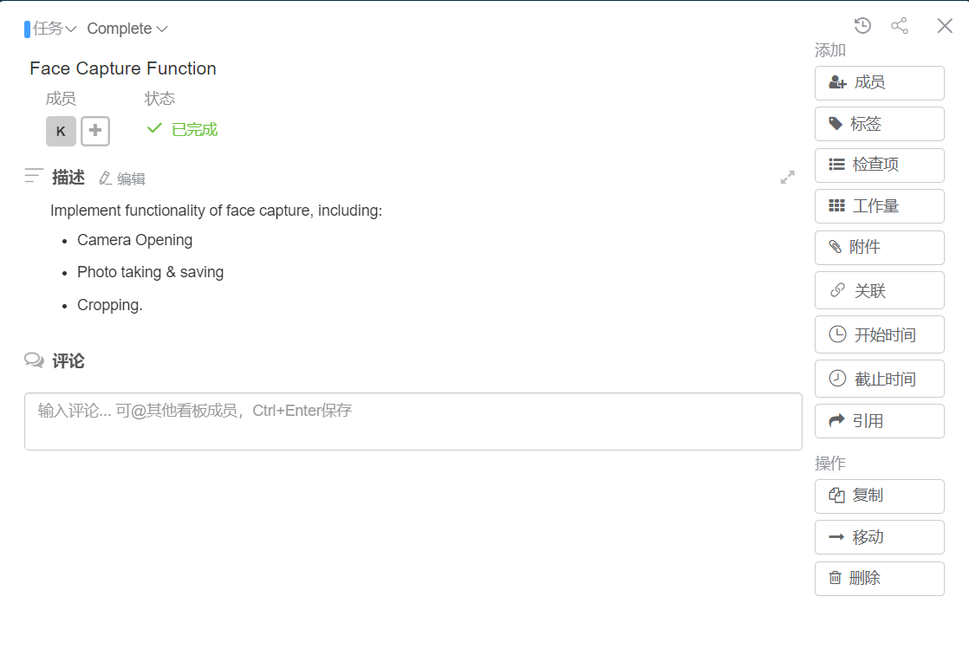
Leangoo – Sprint 1: Face Recognition Prototype

Slide 28
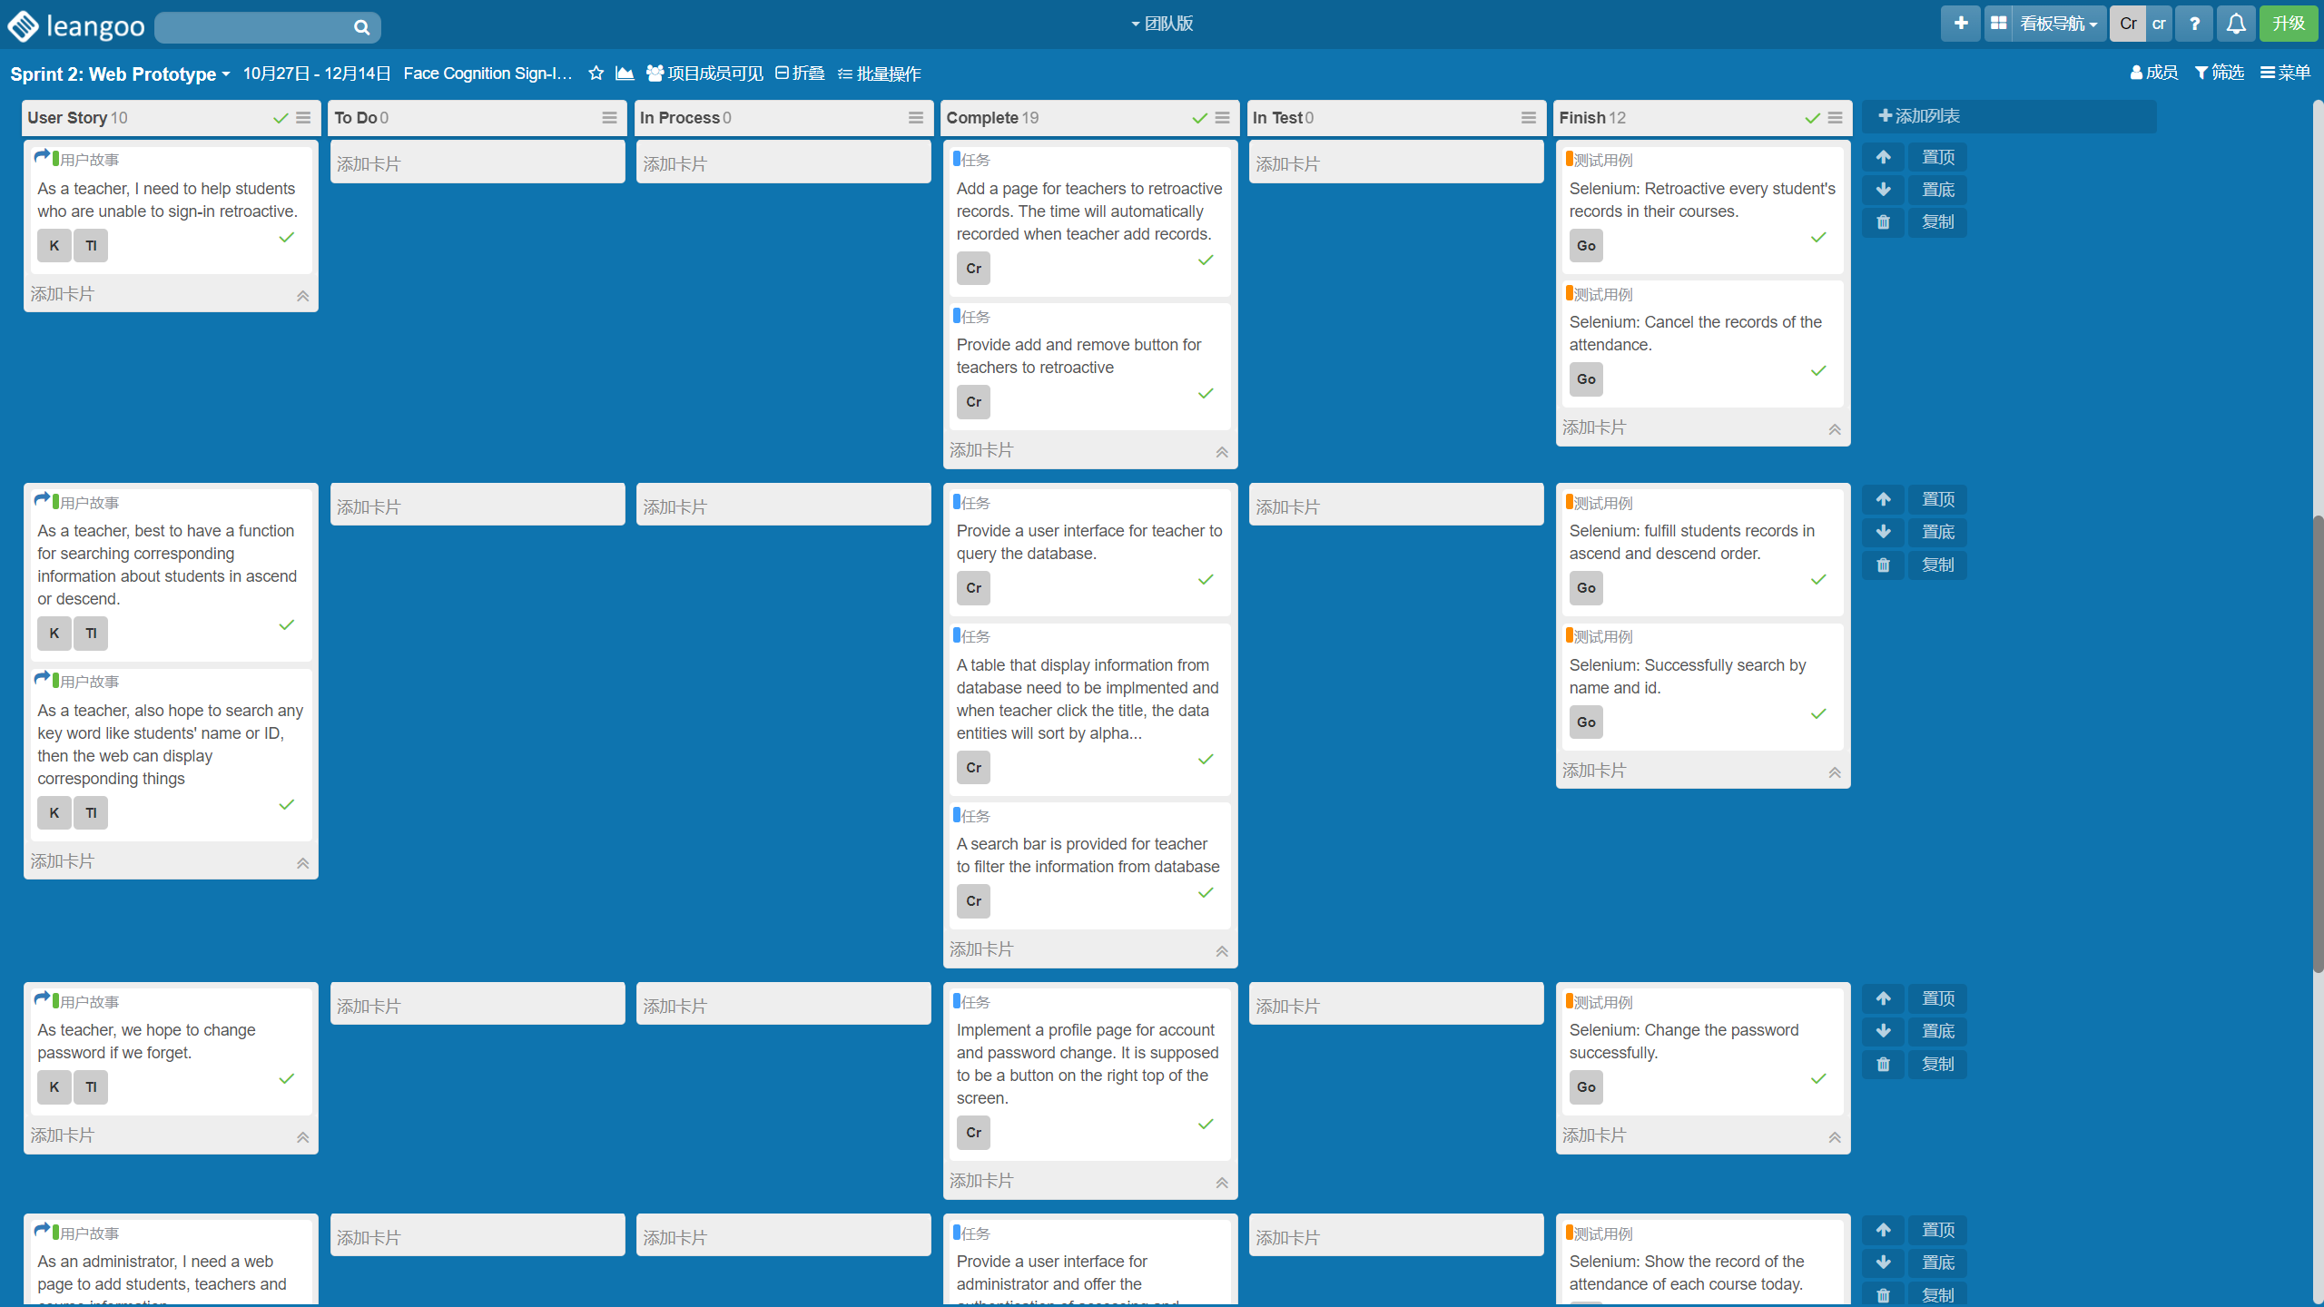
Leangoo – Sprint 2: Web Prototype
Daily Standing Meeting & Demo Meeting

Slide 29
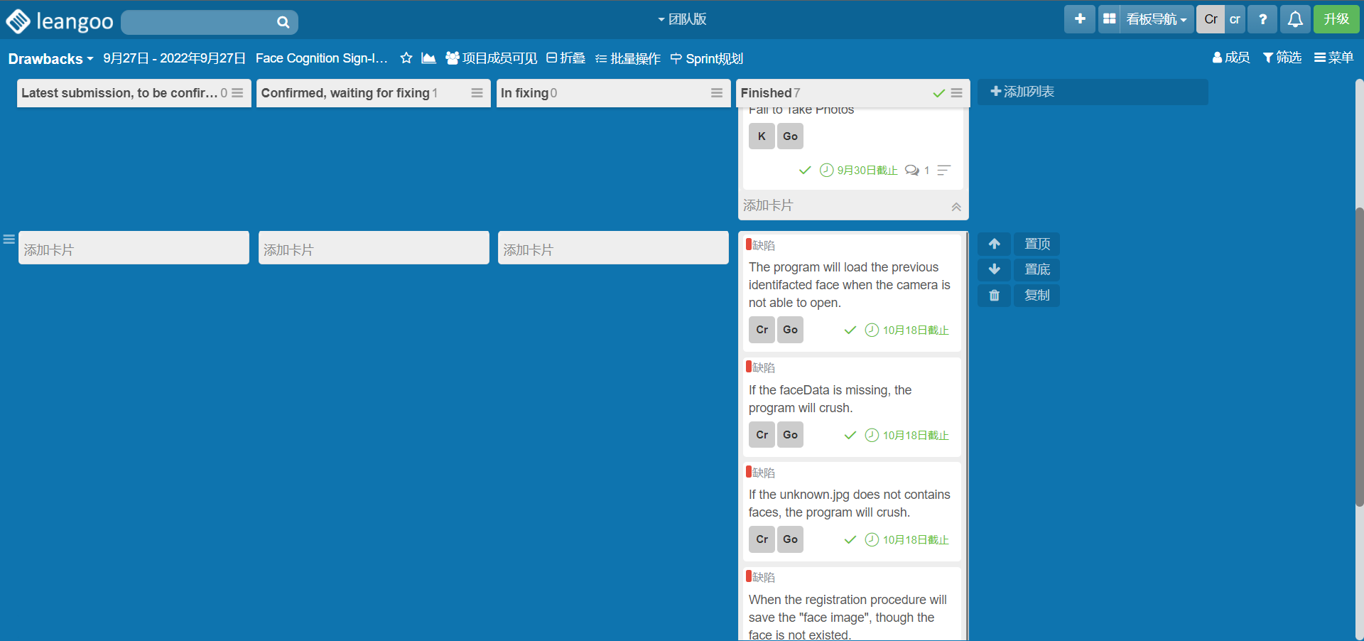
Leangoo – Drawbacks
Daily Standing Meeting & Demo Meeting

Slide 30
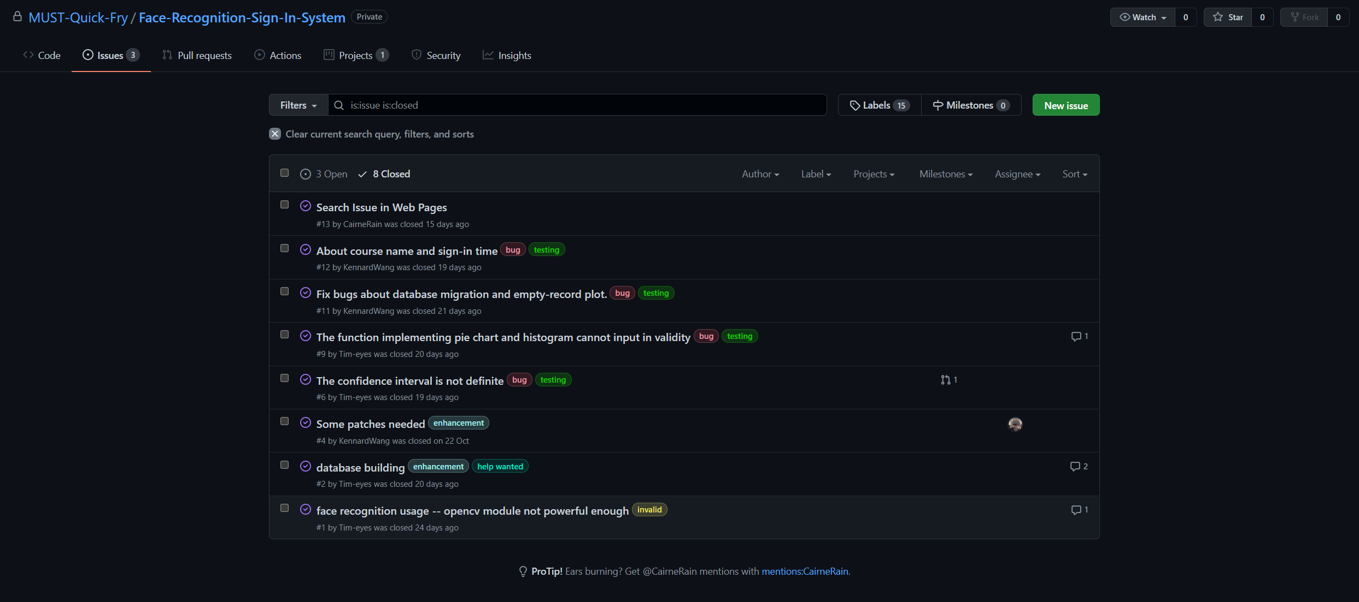
Leangoo – Drawbacks

Slide 31
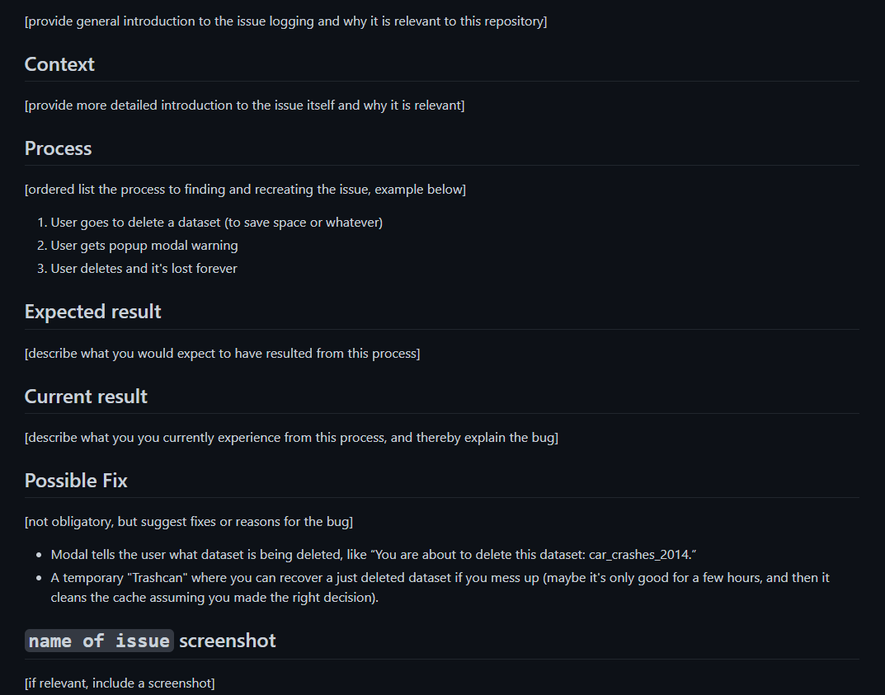
Leangoo – Drawbacks
Issue Report Template

Slide 32
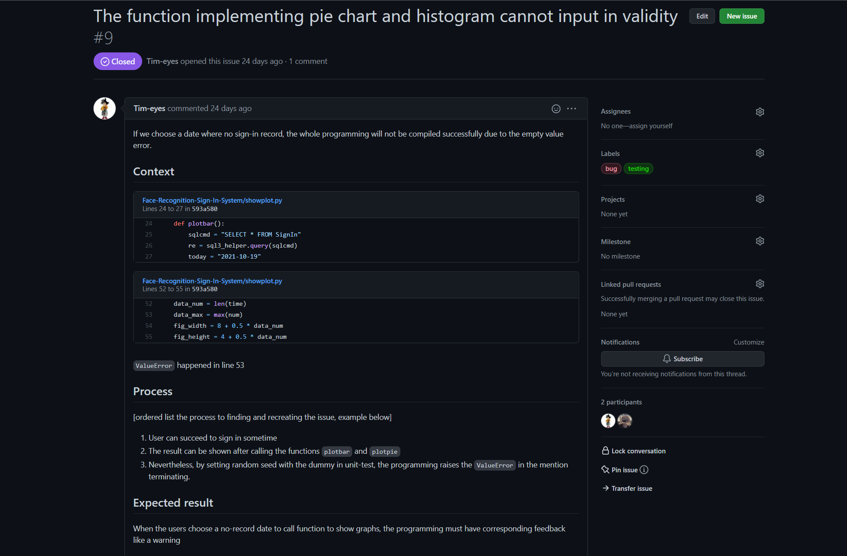
Leangoo – Drawbacks

Slide 33
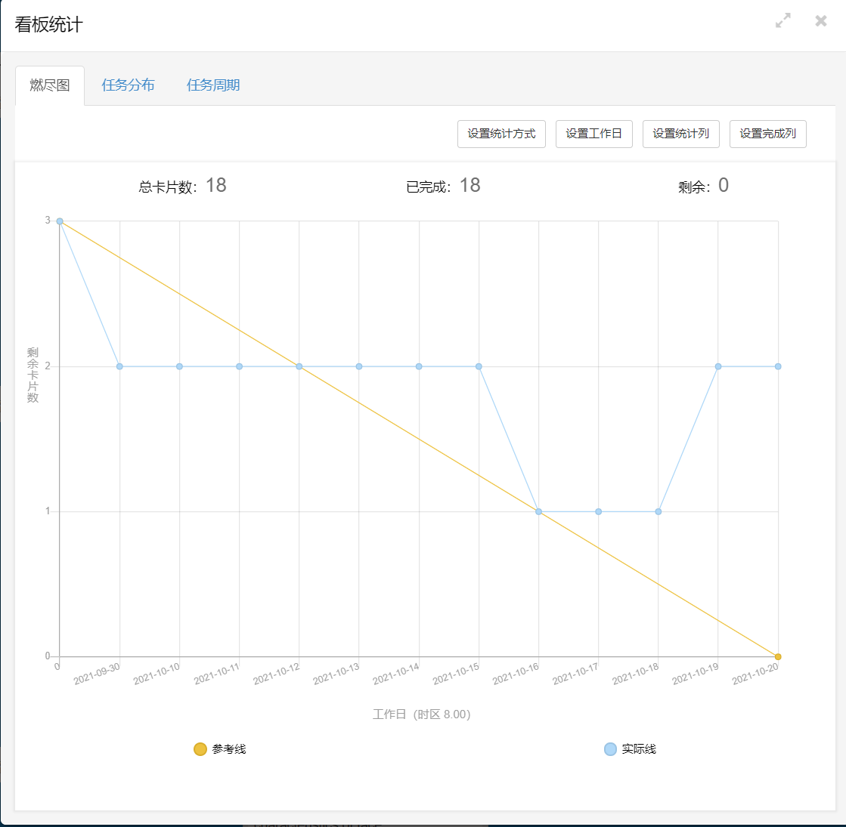
Project
Retrospective Meeting - Burndown Chart

Slide 34
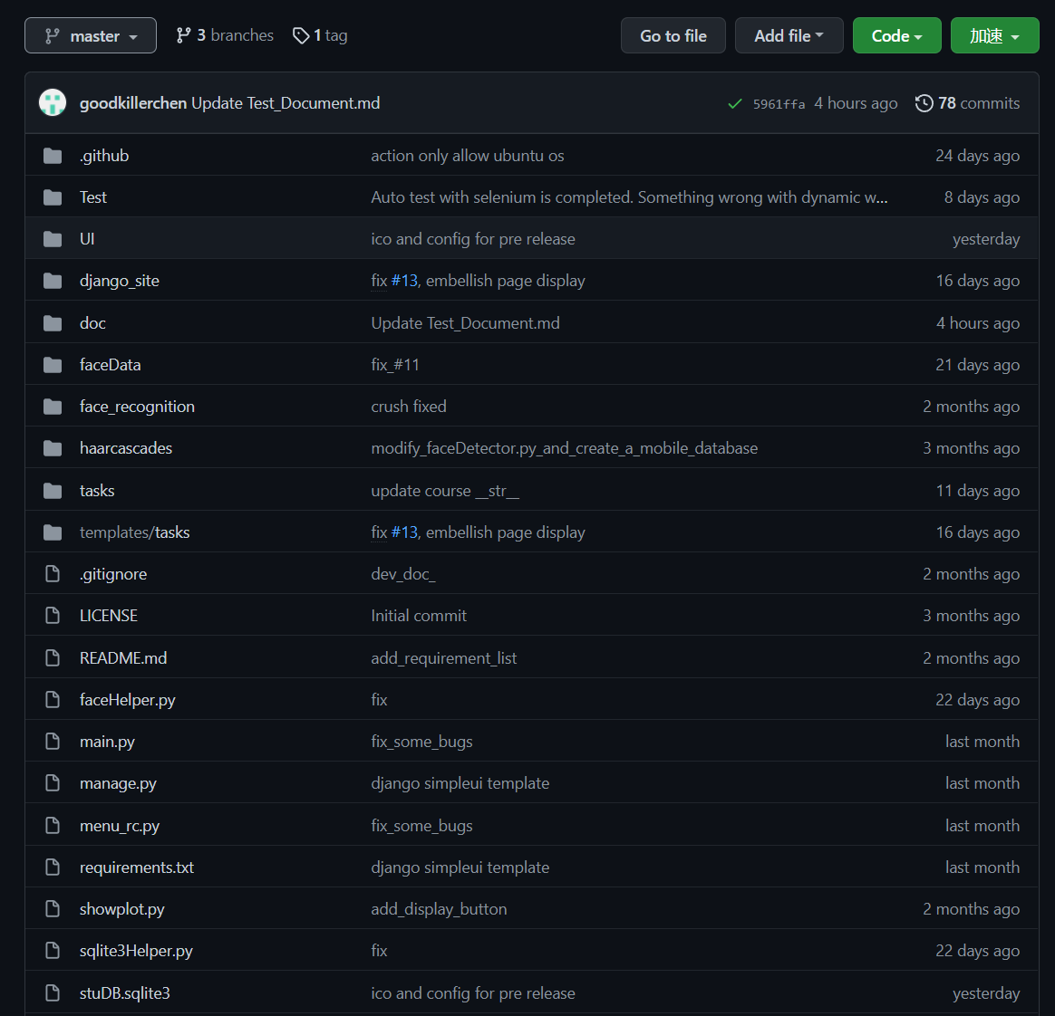
Project
Retrospective Meeting - Commit Message Improvement
After
Before

Slide 35
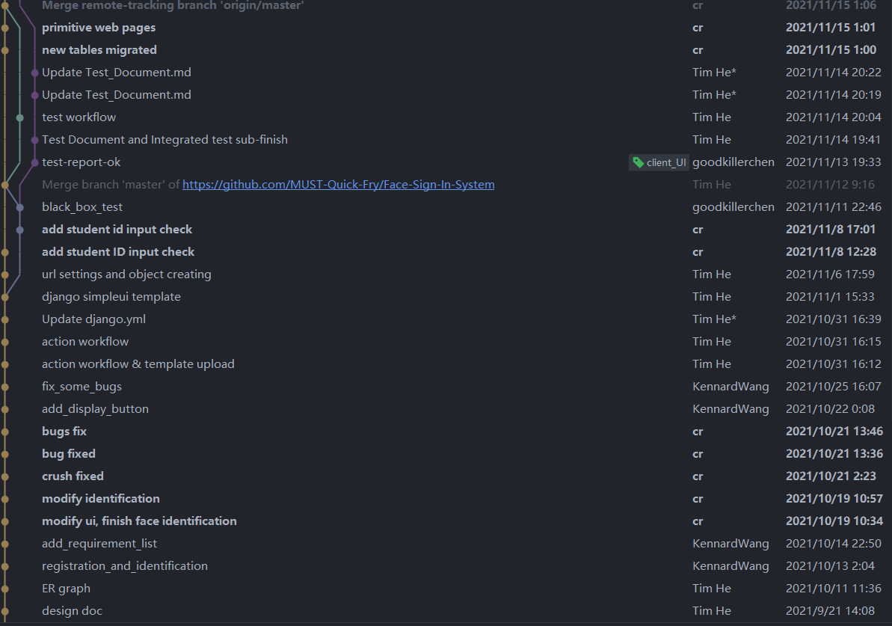
Project
Retrospective Meeting - Git Branch Improvement
After
Before

Slide 36
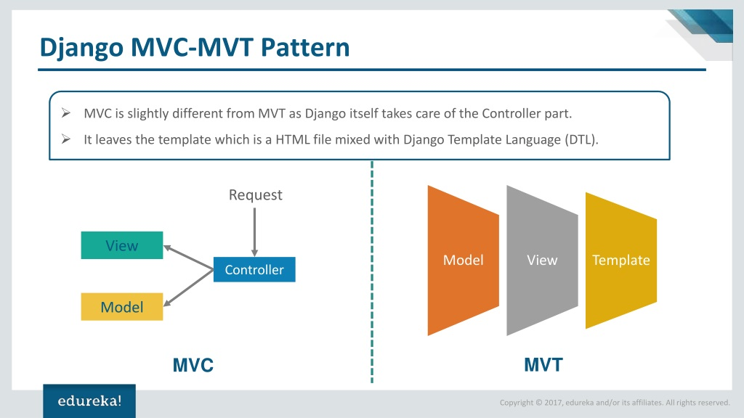
Project
Retrospective Meeting - Pattern Framwork Improvement
Before
After
Chaos
Low readability
Hard to locate bug
Notes:
开发进度、开会效率、文档书写

Slide 37
Testing
Black-box Test
White-box Test
Unit Test & Integration Test
Automation Test

Slide 38
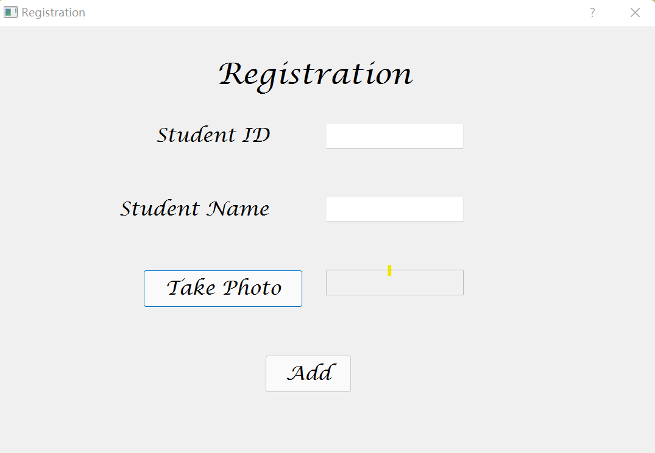
Black-box Test
Black-box Test
Equivalence Class
M1 = {input sid valid}
M2 = {input sid invalid}
M3 = {input sid null}
D1 = {input sname valid}
D2 = {input sname invalid}
D3 = {input sname null}

Slide 39
Black-box Test
Boundary Value Analysis
Student id (fixed 16) : (^[0-9]{4}853[a-zA-Z0-9]{5}[0-9]{4}$)
✔ Valid input: 1809853zi0110099
❌ Invalid input: 1809853zi011009 (length: 15)
❌ Invalid input: 1809853zi01100901 (length: 17)
❌ Invalid input: 1809😂😂😂😂 (format fail)
Student name : ([a-zA-Z]{2,20})
✔ Valid input: cr (length:2)
✔ Valid input: Romanadveratrelunder (length:20)
✔ Valid input: WangYuYang
❌ Invalid input: a
❌ Invalid input: Polyentolyekmongtainh (length:21)
❌ Invalid input: (^-^)(^-^)(^-^) (format fail)

Slide 40
Black-box Test
Decision Table
Condition Stub
C1: input sid in {M1,M2,M3}
C2: input sname in {D1,D2,D3}
C3: whether take photo in {yes, no}
C4: press the add button
Action Stub
A1: registration success
A2: Error exception

Slide 41
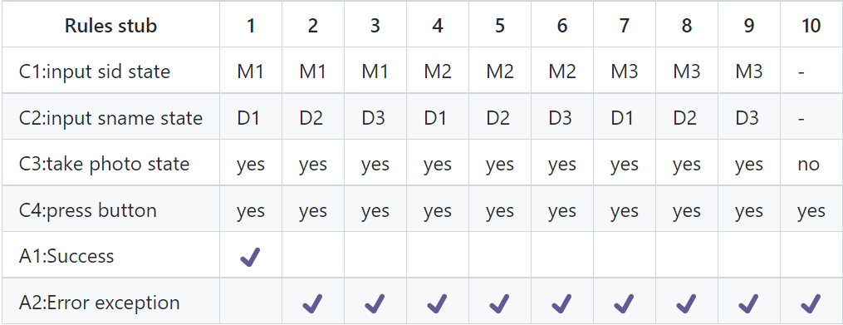
Black-box Test
Decision Table

Slide 42
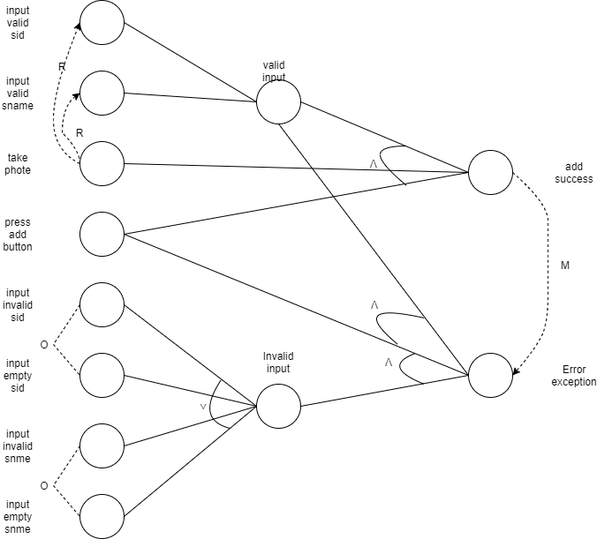
Black-box Test
Effect Diagram

Slide 43
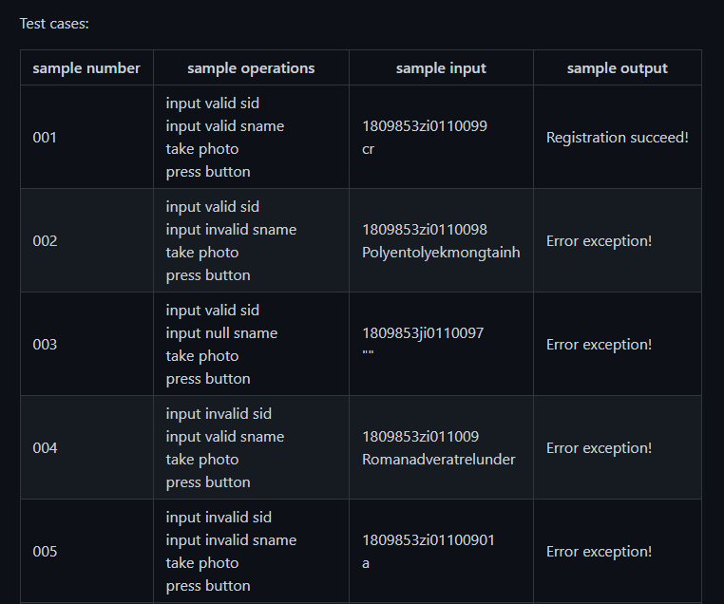
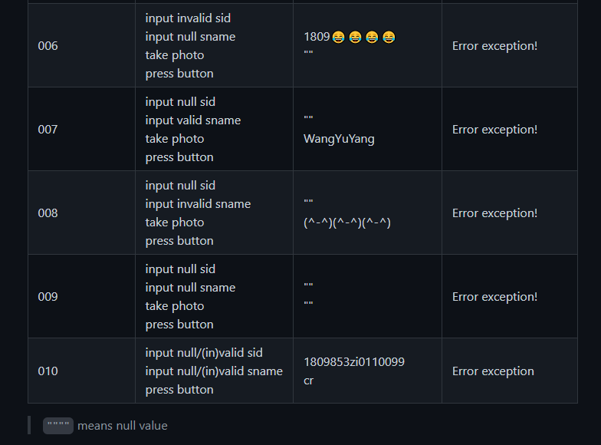
Black-box Test
Test Cases

Slide 44
White-box Test
White-box Test
Static White-Box Testing
Dynamic White-Box Testing

Slide 45

White-box Test
Static Test Tool - Pylint
Fix static logic-bugs
Identify code styles

Slide 46
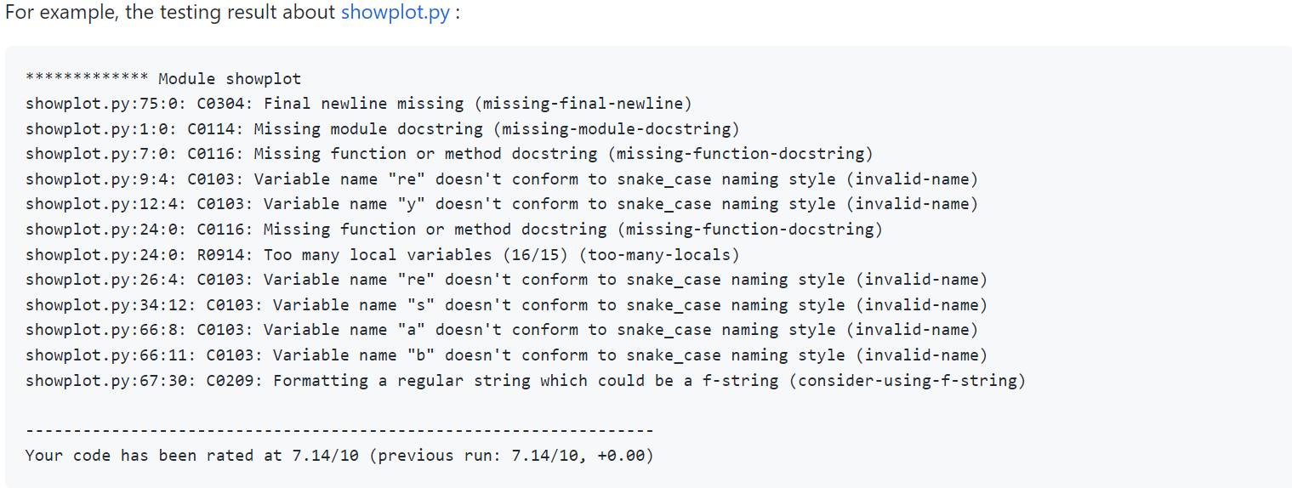
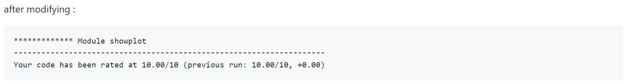
White-box Test
Desk Checking - Pylint

Slide 47
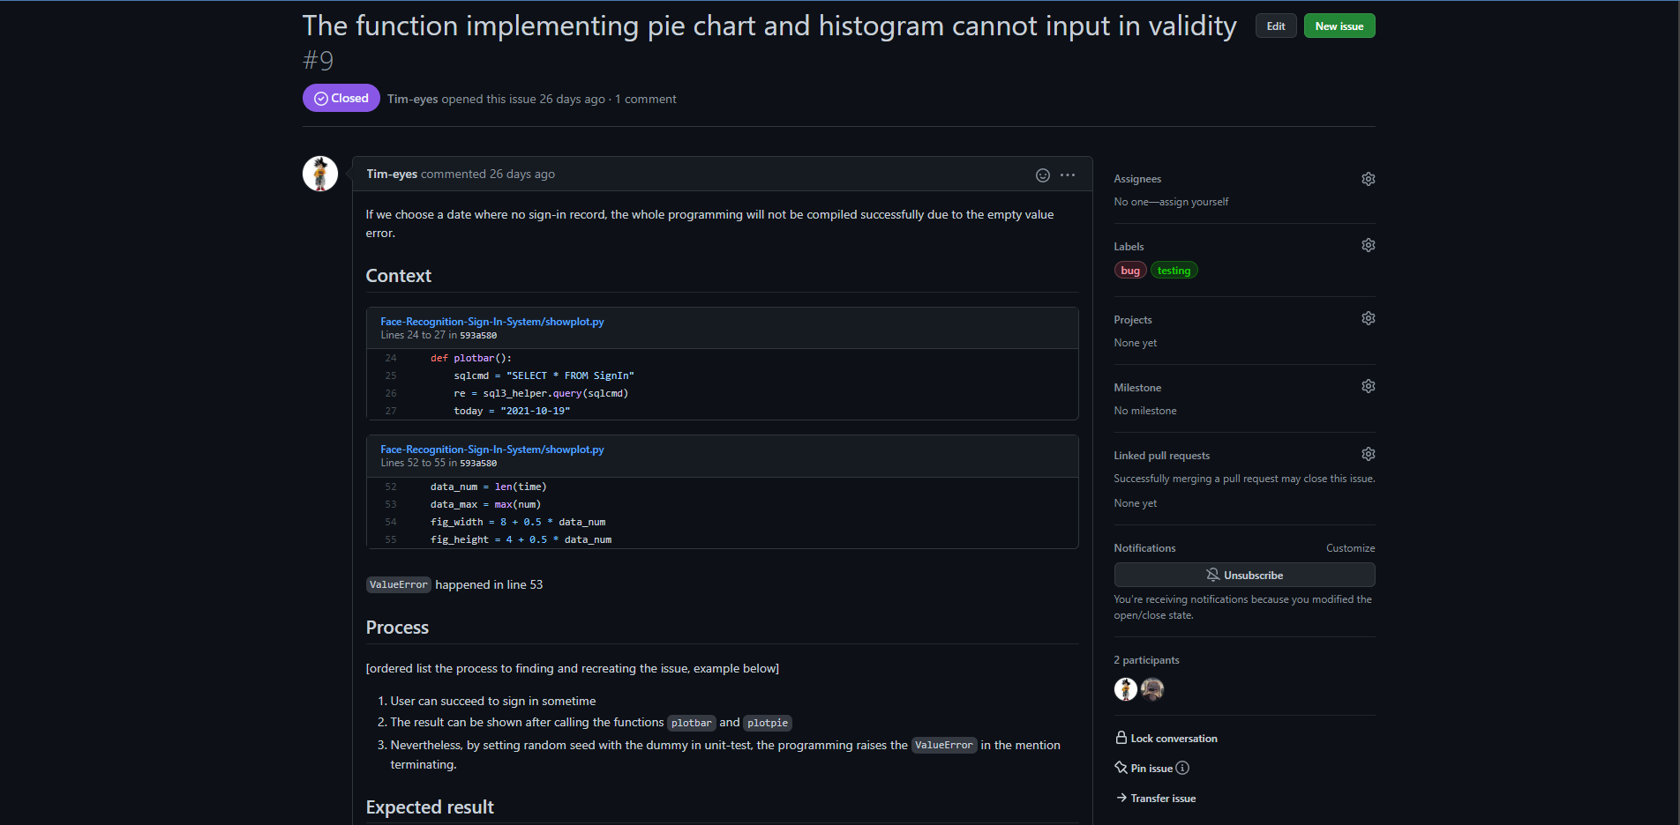
White-box Test
Colleague Inspection

Slide 48
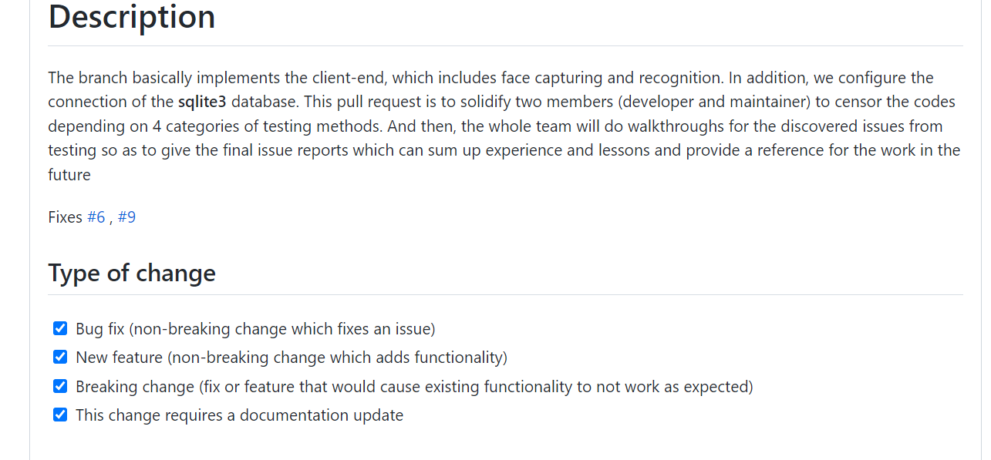
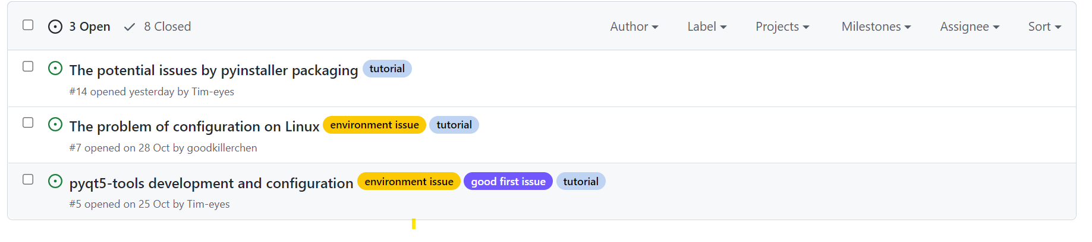
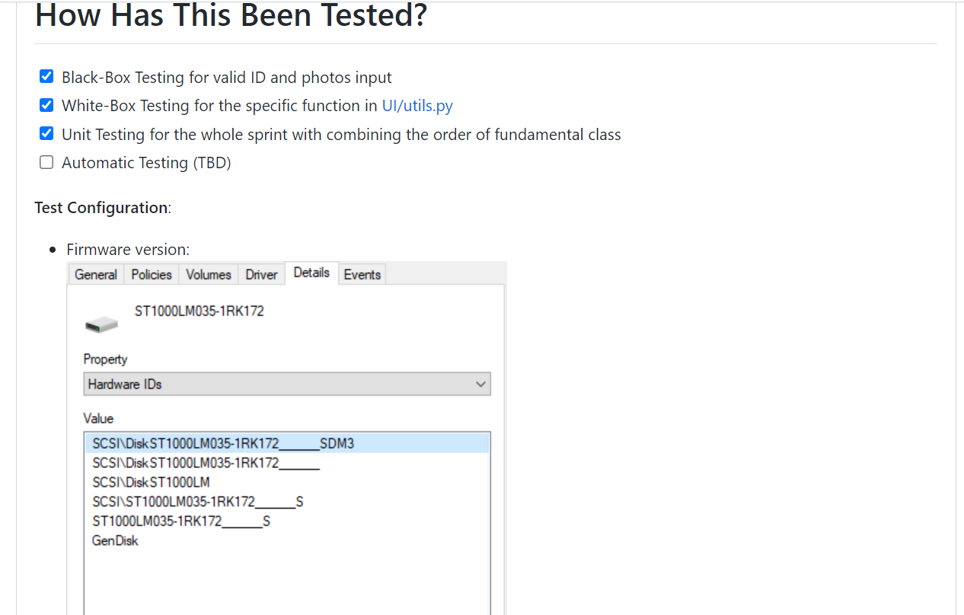
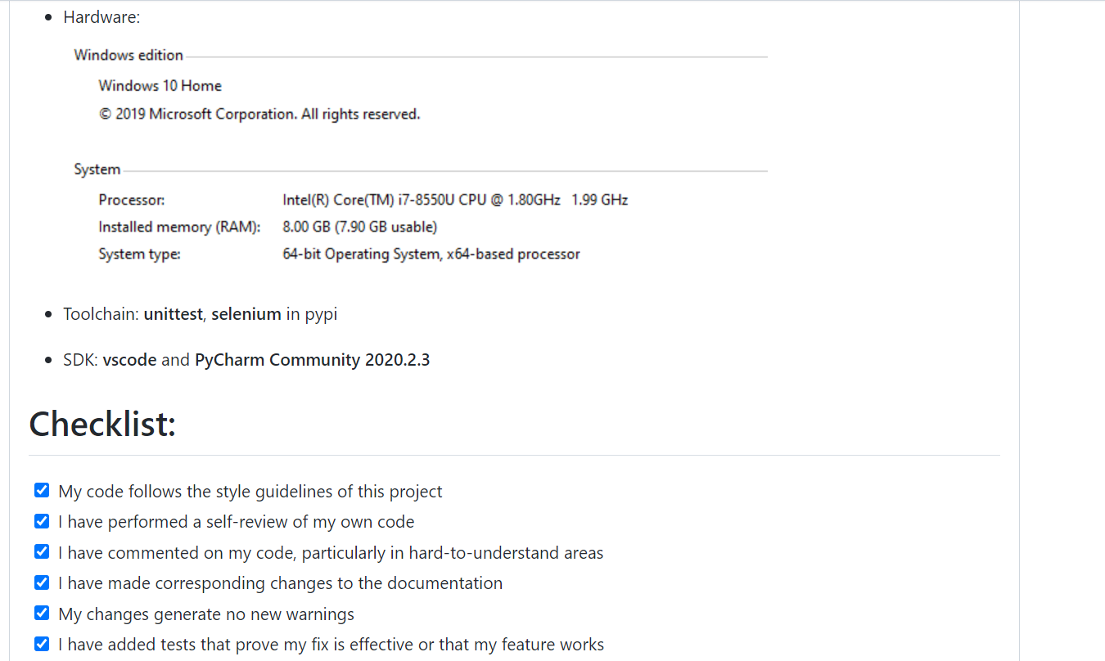
White-box Test
Code Walkthrough

Slide 49
White-box Test
Dynamic White-box Test
Statement coverage
Decision coverage
Condition coverage
Decision/condition coverage
Combination coverage
Independent path

Slide 50
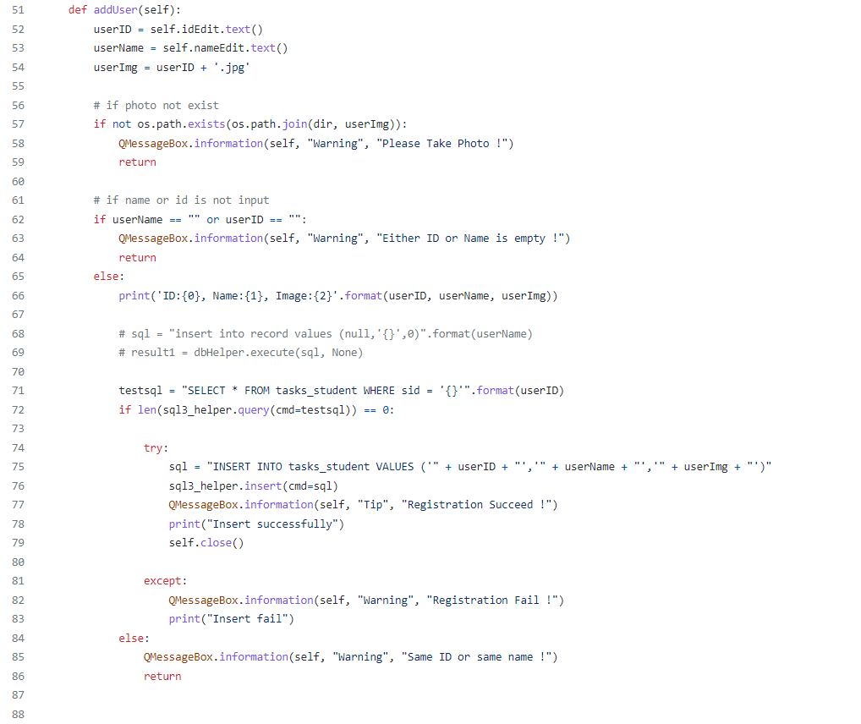
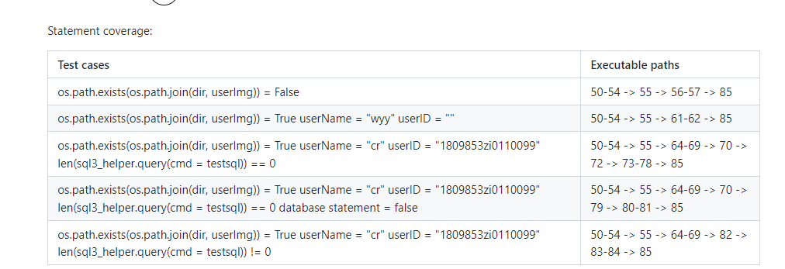
White-box Test
Statement & Decision Coverage

Slide 51
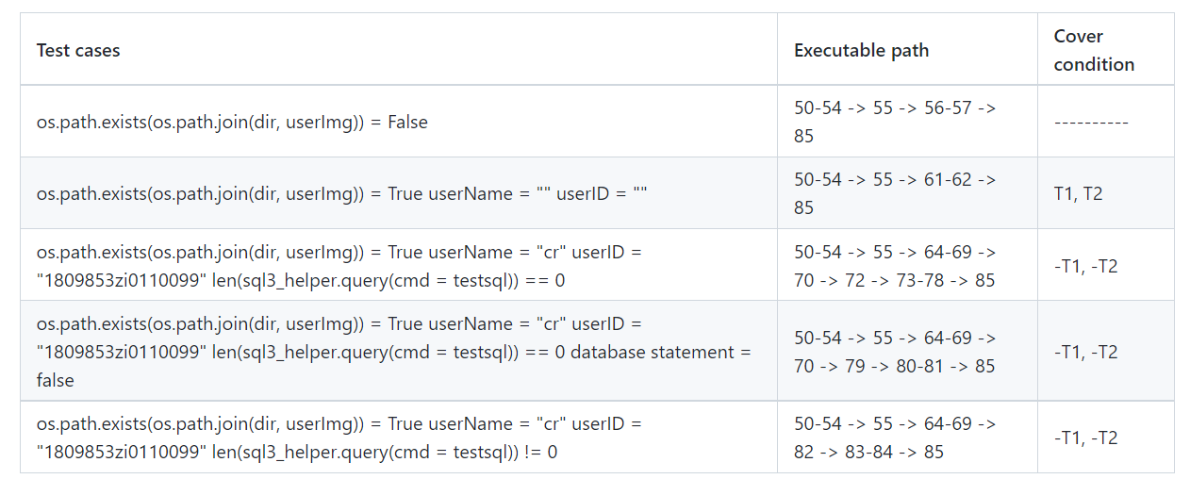
White-box Test
Decision/Condition Coverage
if userName == "" or userID == ""
userName = "" is true : T1
else : -T1
userId = "" is true : T2
else : -T2

Slide 52
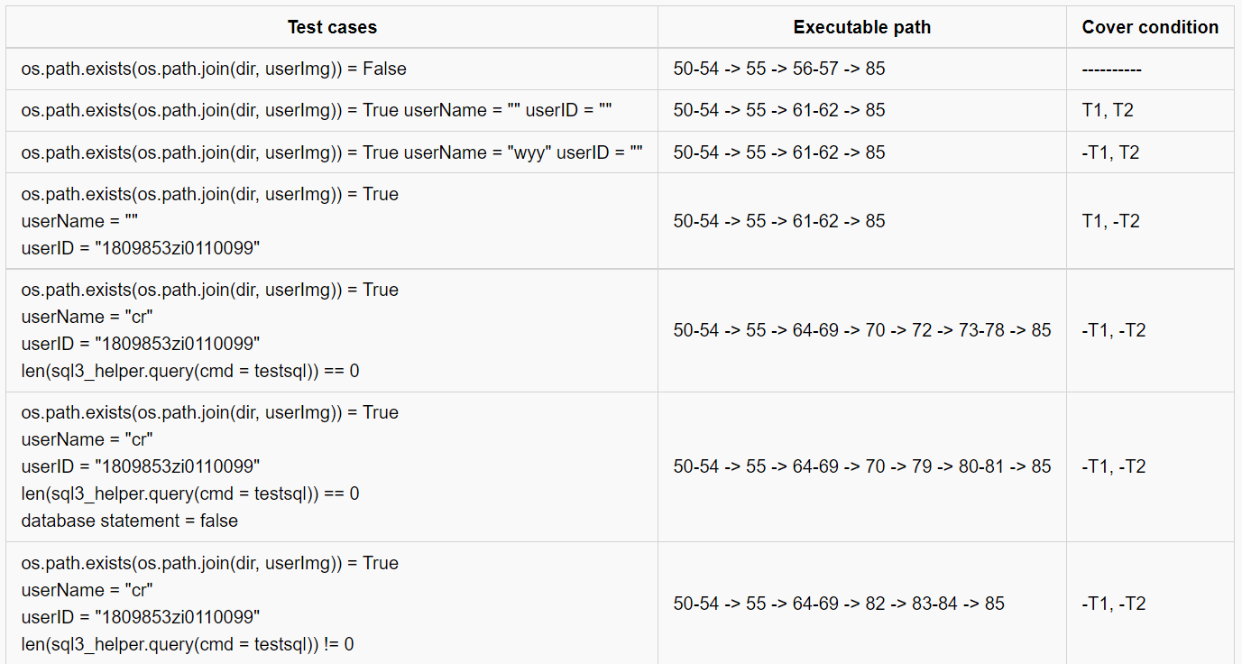
White-box Test
Combination Coverage

Slide 53
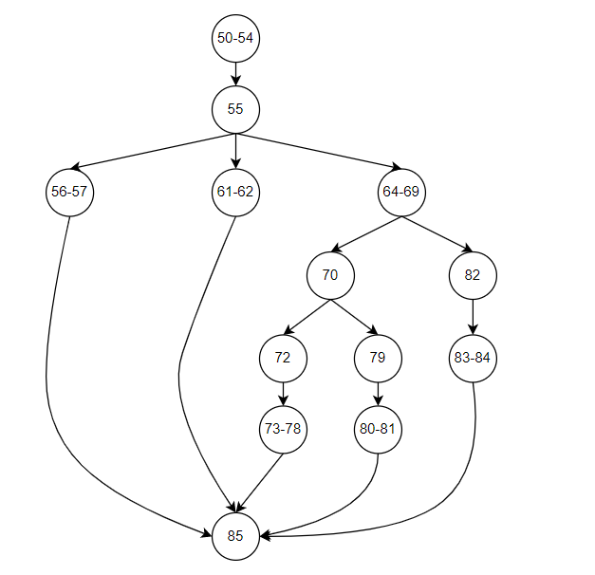
White-box Test
Control Flow Graph
The loop complexity is 5
Independent Path
50-54 -> 55 -> 56-57 -> 85
50-54 -> 55 -> 61-62 -> 85
50-54 -> 55 -> 64-69 -> 70 -> 72 -> 73-78 -> 85
50-54 -> 55 -> 64-69 -> 70 -> 79 -> 80-81 -> 85
50-54 -> 55 -> 64-69 -> 82 -> 83-84 -> 85

Slide 54
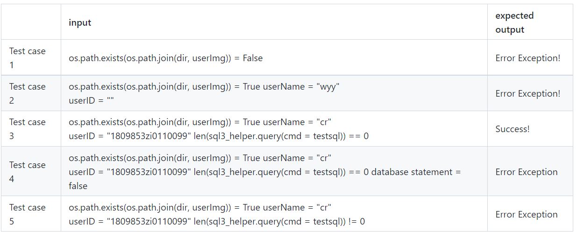
White-box Test
Test cases

Slide 55
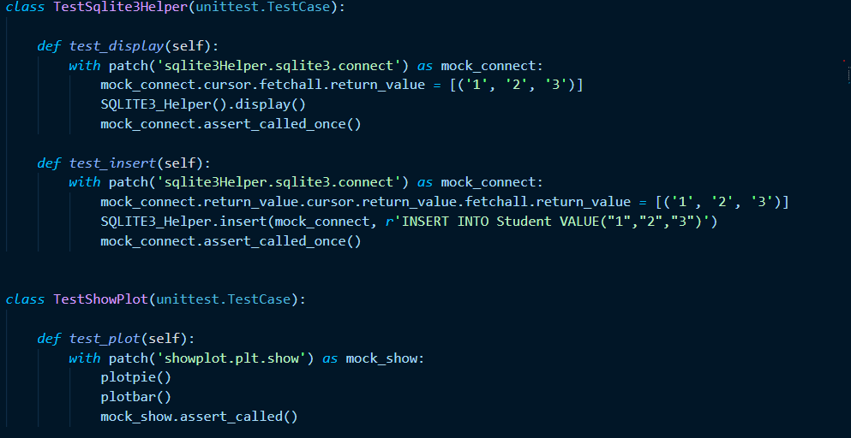
Unit Test & Integration Test
Unit Test & Integration Test
Unit Test
Mainly testing for sprint1—ClientUI
unittest in python
Test double : Mock
Integration Test
Run all part of unit test cases
Define and package the test suit
Testing fundamental interfaces of sqlite3 DB and statistic function

Slide 56
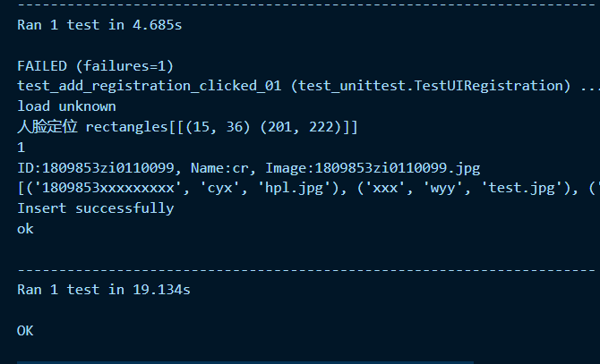
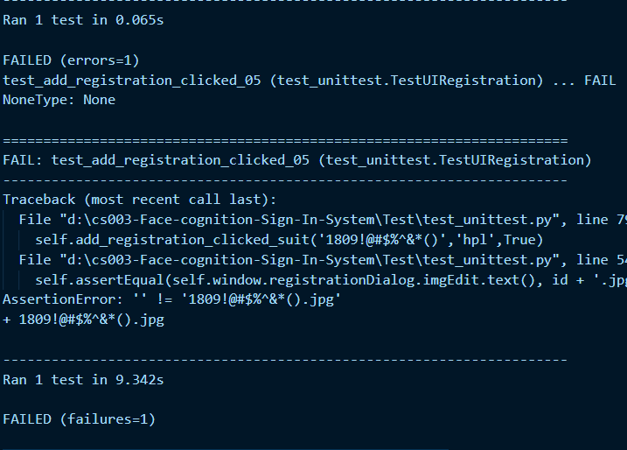
Unit Test & Integration Test
Testing the cases generated by Black-Box and White-Box
Test Case #1 with valid result
Test Case #5 with invalid result
Message from Python Testing Log

Slide 57
Automation Test
Automation Test Tool - Selenium
Login
Retroactive records
Show records
Add (cancel) course/teacher/student
Change password
Search

Slide 58
Management
Team Structure
PERT Chart
Gantt Chart
Software Quality Assurance

Slide 59
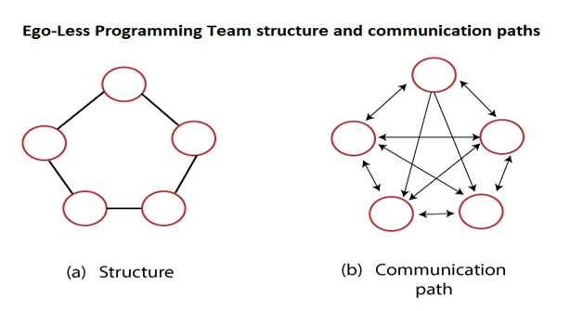
Team Structure
Team Structure - Egoless
Our software engineering team is organized within an egoless and democratic management module.

Slide 60
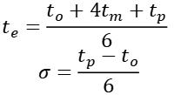
PERT Chart
PERT Chart
$$t_{e}=\frac{t_{o}+4t_{m}+t_{p}}{6}$$
$$σ=\frac{t_{p}−t_{o}}{6}$$

Slide 61
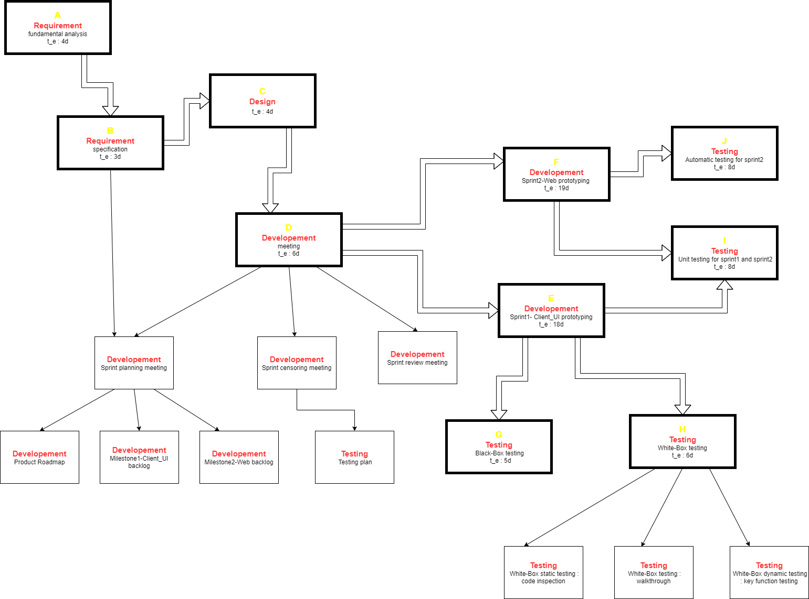
PERT Chart
PERT Chart

Slide 62
Gantt Chart
Gantt Chart

Slide 63

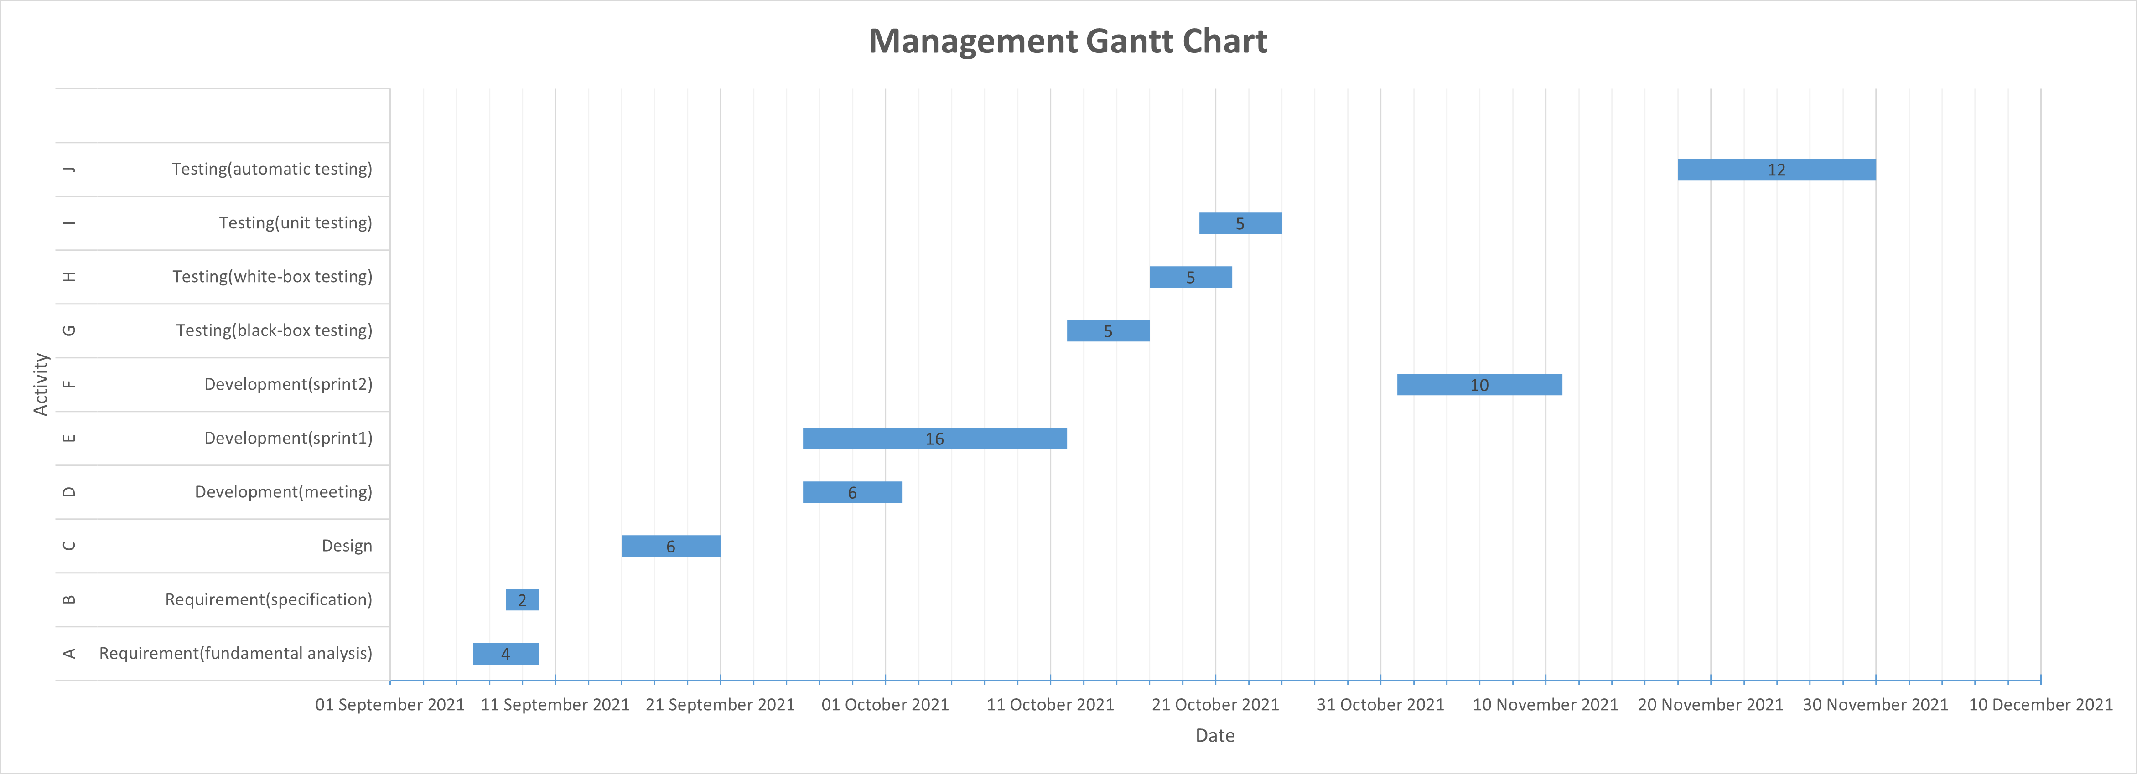
Gantt Chart
Gantt Chart

Slide 64
Software Quality Assurance
Quality Assurance
CMM2 Model -- repeatable and owning project-level thinking.
Use the basic project management process to track the progress, function and quality of the project.
Previous project experience can be applied to the current project.
Use a certain degree of organization and basic software testing behaviors, such as software testing plans.
Test Case Key Process Area (KPA)

Slide 65
THANK YOU FOR YOUR GUIDANCE!

